Slide 1
Destruction of Aqueous Microfibers Enzymatically (DAME)
Yogindra Raghav

Slide 2
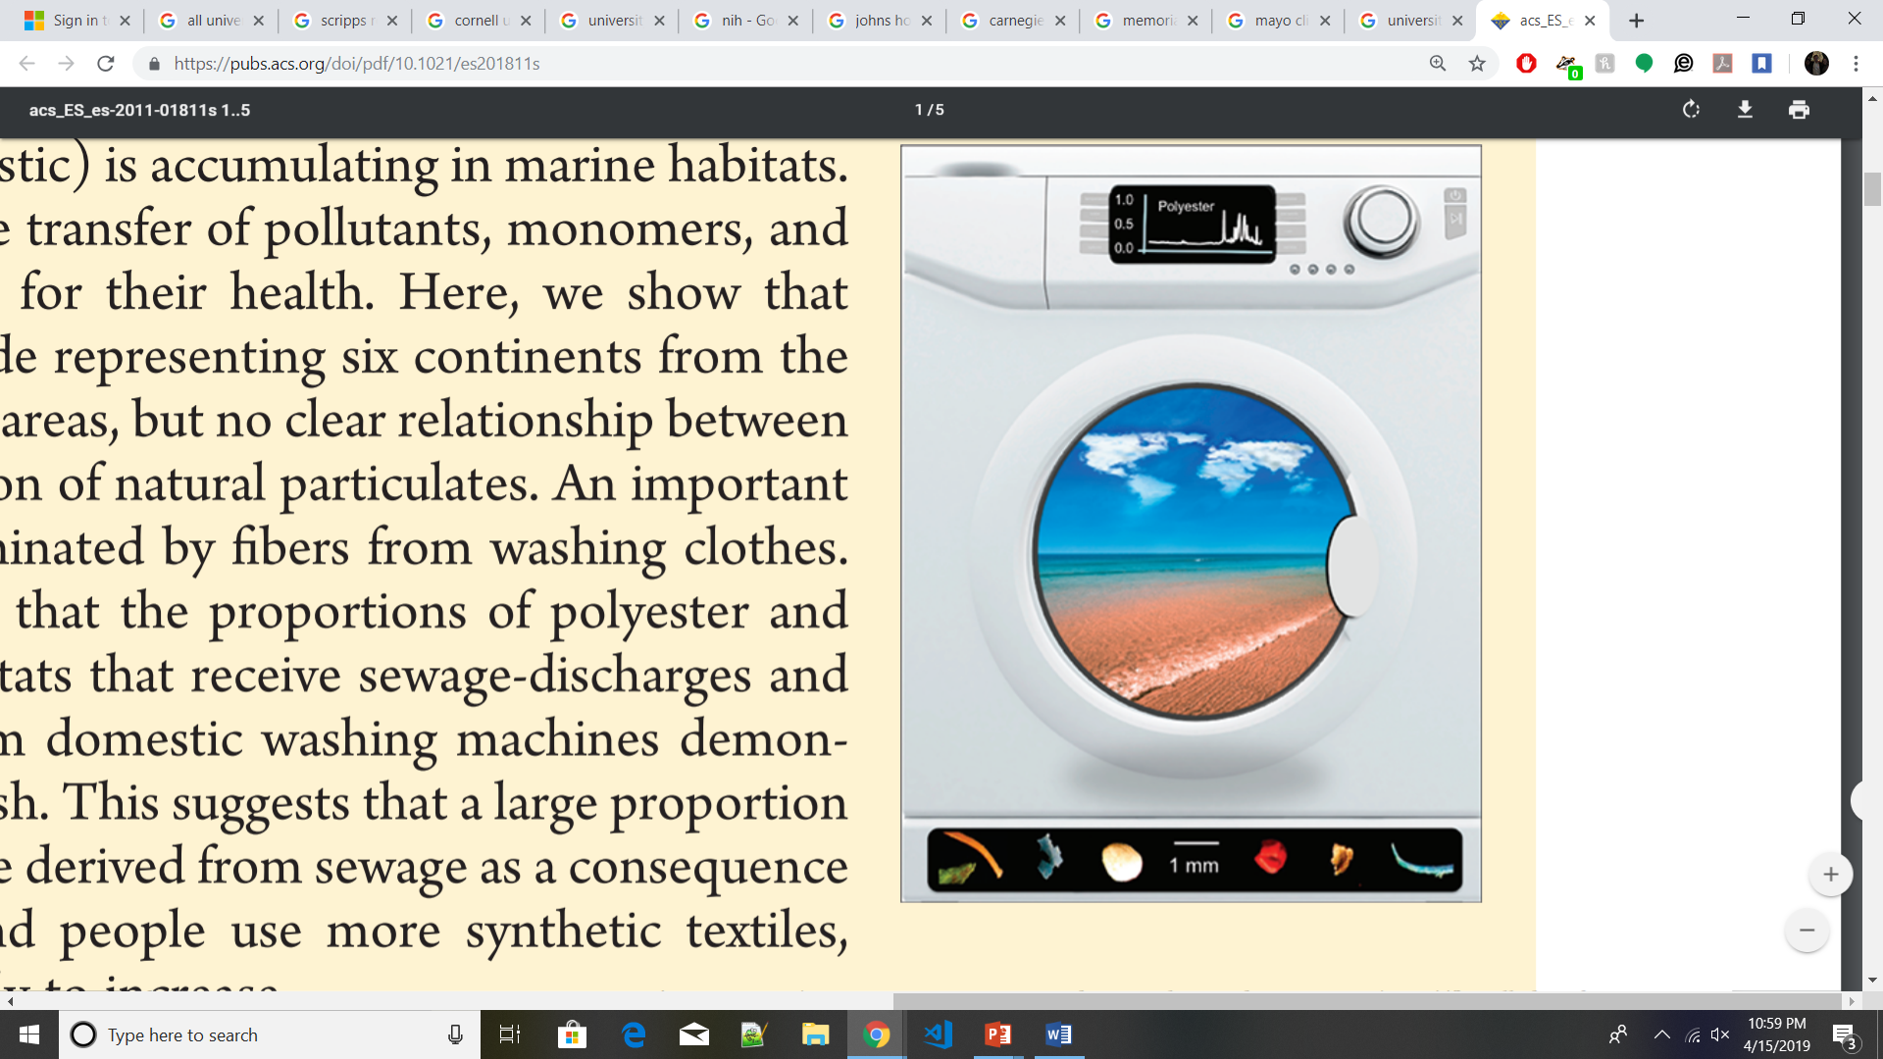
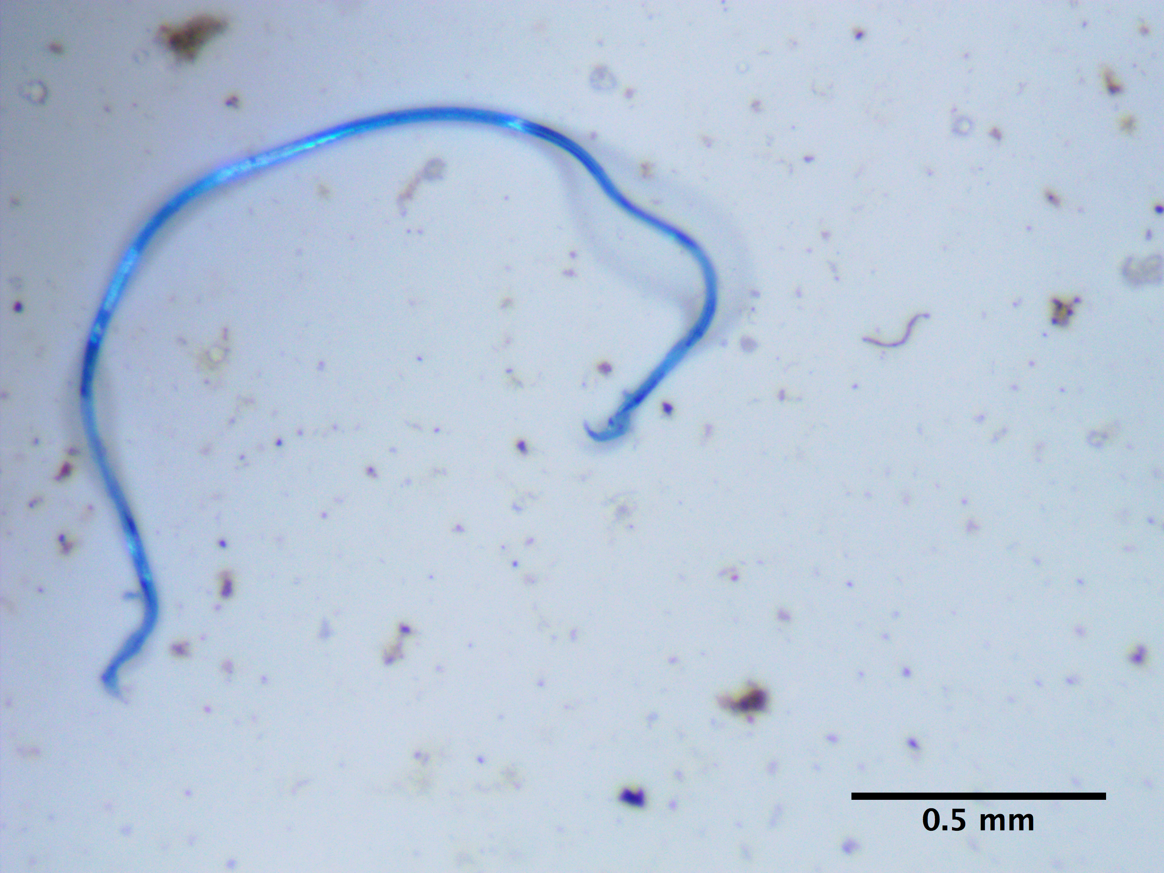
Microfibers: Small Pieces of Synthetic Polymer Caused by Washing Machines

Slide 3
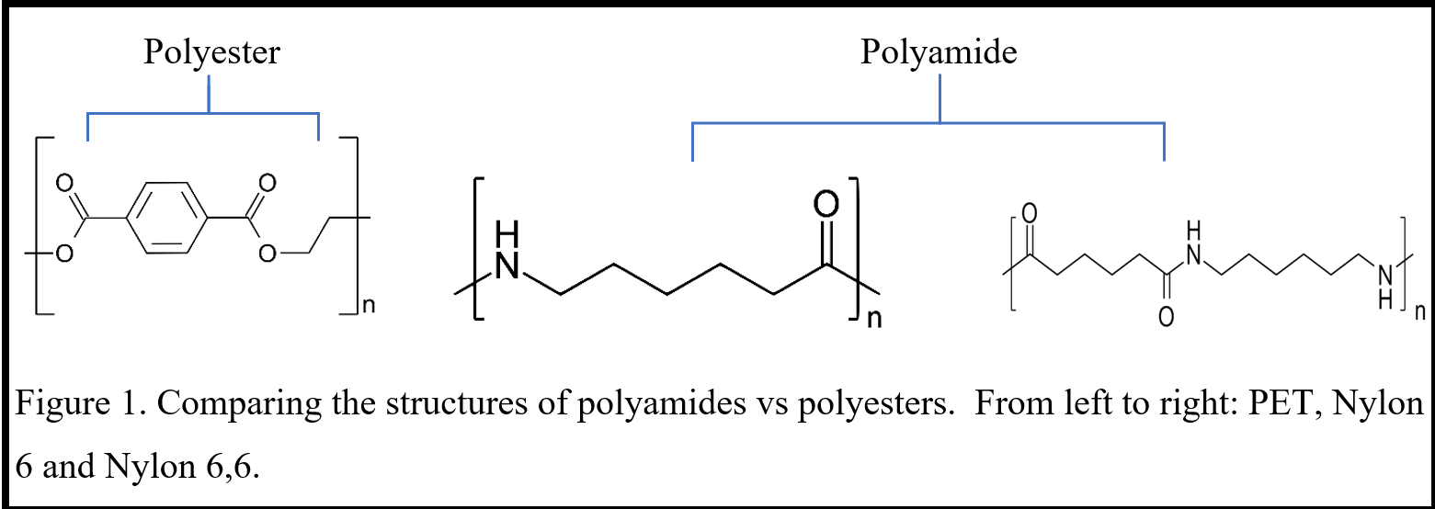
Polyesters and Polyamides Are the Two Major Synthetic Polymers

Slide 4
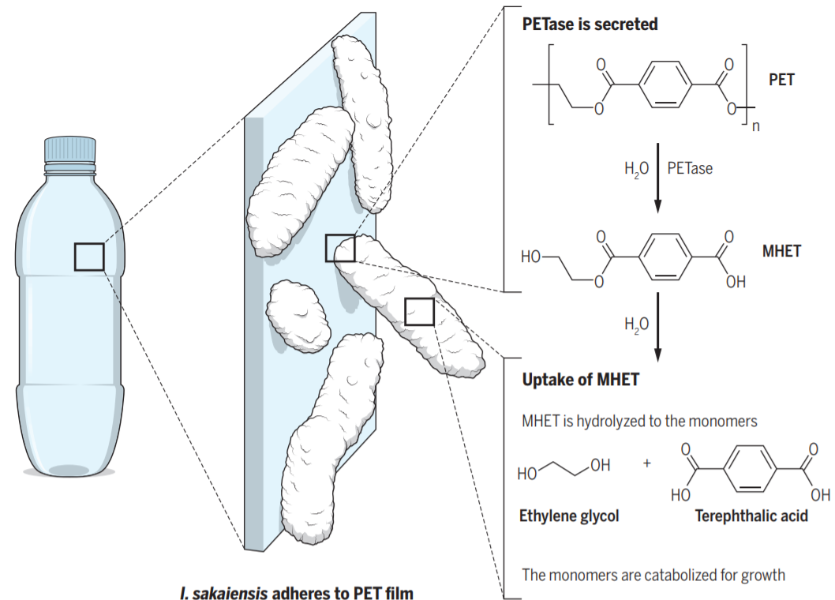
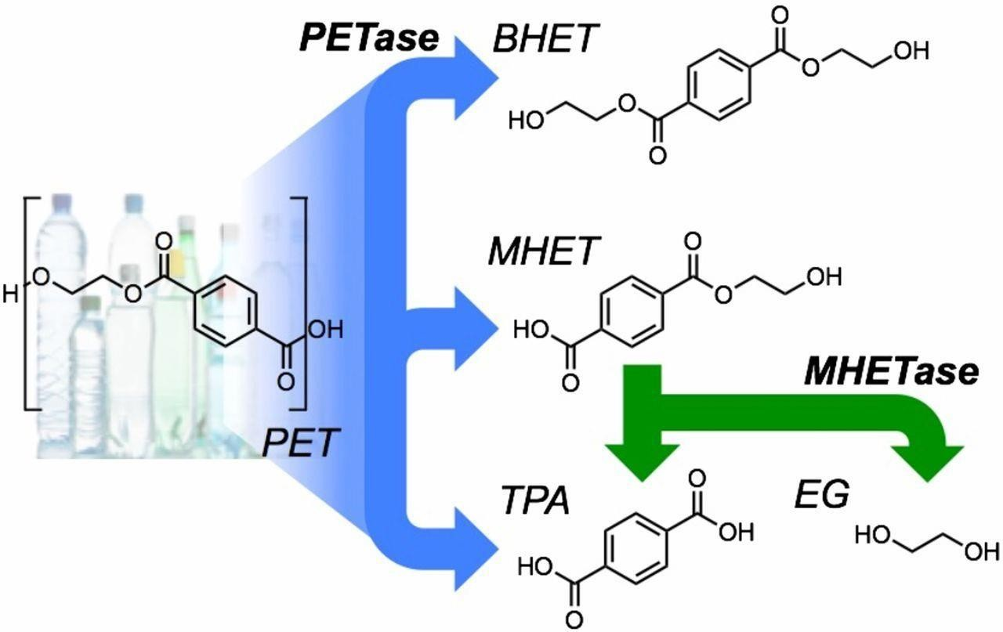
A Novel Bacteria Degrading PET and the Enzymatic Chemistry Behind It

Slide 5
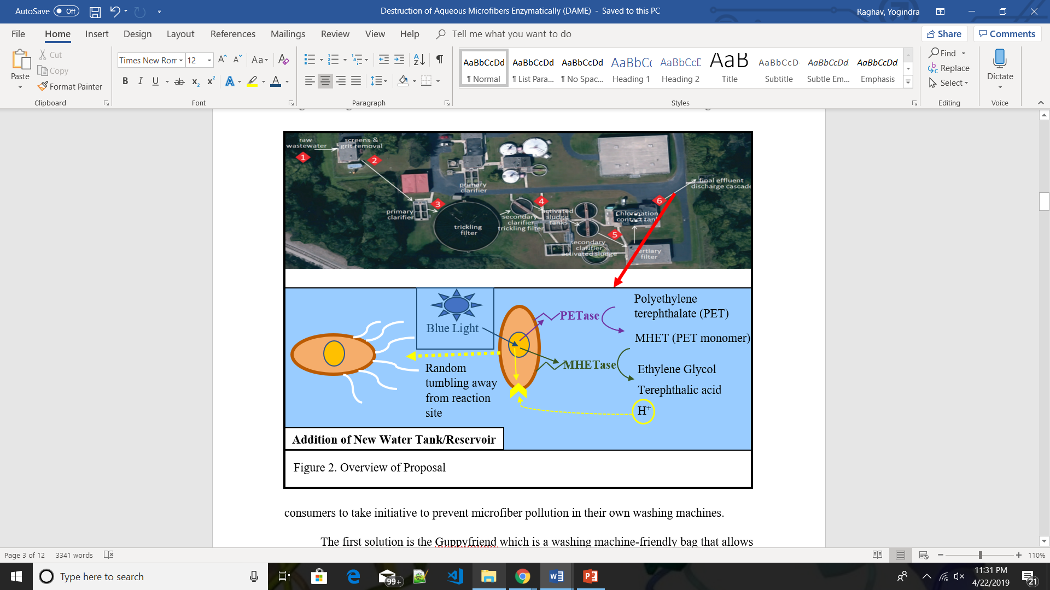
The Overall Design: What Everyone Has Been Waiting For

Slide 6

Questions, Comments, Considerations, Issues?
I’m all ears, so let’s begin the grilling session.

